Slide 1


Python Webapp Programming
Questionnaire app with Django
--Add Static Files, Add Tests

Slide 2
Add APP static files
We will add 1 css file and 2 image files, these will be 3 static files in our app.
You can download 2 image files by yourself and copy to the specified directory to be used.
PS> cd QuestionPrj/QuestionApp
PS> mkdir static
PS> cd static
PS> mkdir QuestionApp
PS> cd QuestionApp
PS> mkdir css
PS> cd css
PS> ni style.css
PS> cd ..
PS> mkdir img
PS> cp d:/bonov/downloads/art-questionnaire.png img/
PS> cp d:/bonov/downloads/clip-question.png img/

Slide 3
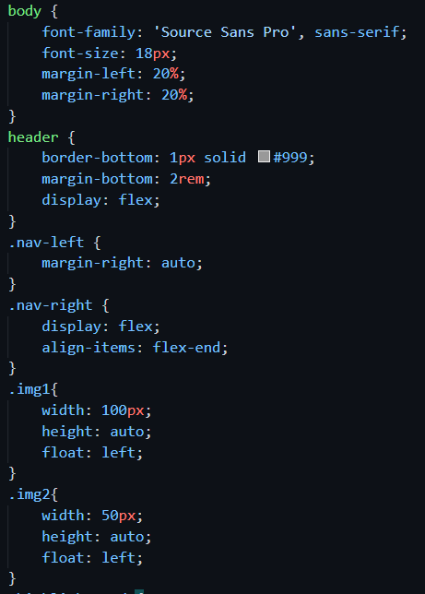
Add APP static files
Add the following content to the .css file.
Modify base.html, home.html, make use the css and image files
The style.css
Scale the image size
Image float left.
Overall content left some margin
Two style for 2 columns in header of body (nav-left and nav-right)

Slide 4
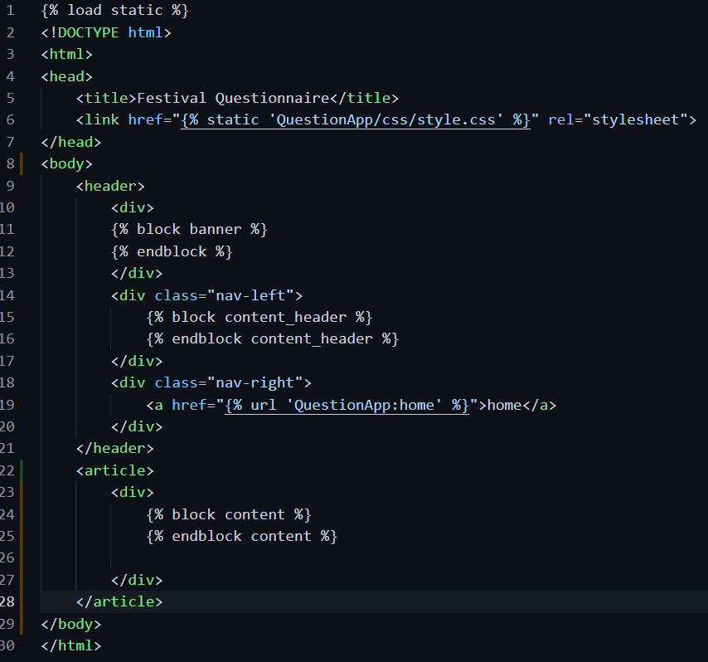
Add a static style file in base.html. This will be used by all files and files extends base.html
Inside <header>, use <div> split 3 columns
Add a placeholder for image.
A placeholder for content header text.
A placeholder for page main content

Slide 5
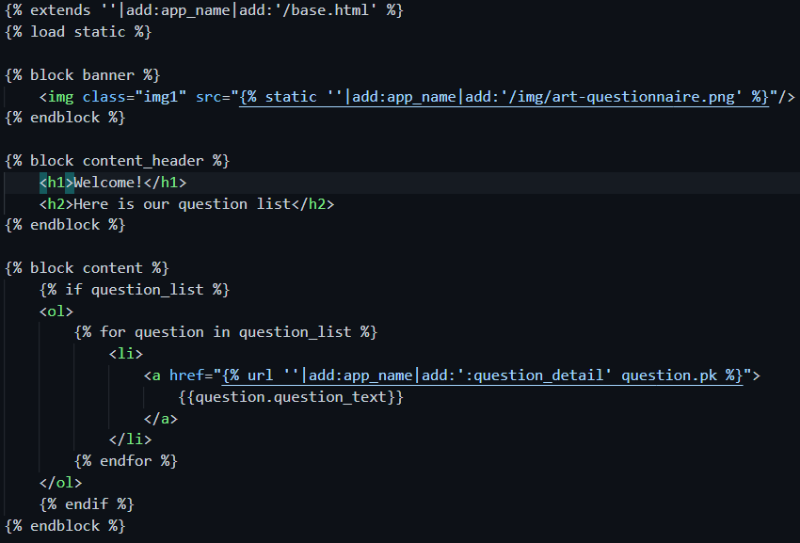
Add a static image for home page

Slide 6
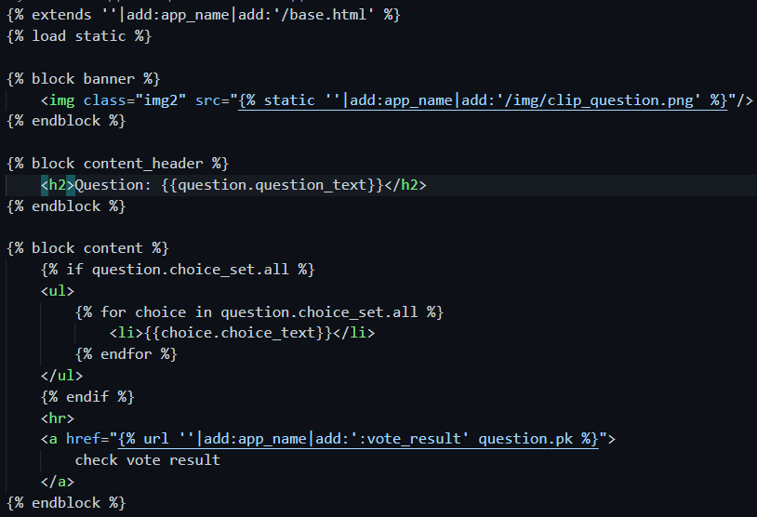
Add a static image for detail page template

Slide 7
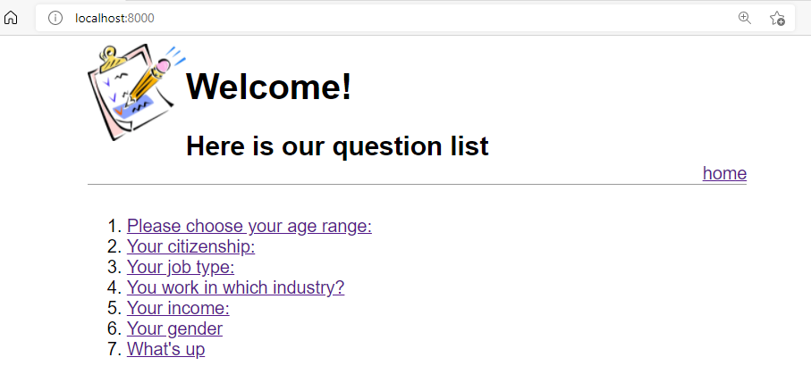
Check the new page

Slide 8
Push new version to repo, deploy to Heroku, and visit your cloud site
PS> cd QuestionPrj
PS> git status
PS> git add –A
PS> git commit –m “add static files deploy”
PS> git push origin main
PS> git push heroku main
PS> heroku ps:scale web=1

Slide 9
Hot to test our code
Test is important. It helps to make sure program runs correct at a basic level.
Test needs to be automated, so that every time we change the code, can run test in an easy way, thus verify our change are good, not introduce any mistake into the program.
Django
Comes with an easy-to-use test framework
Add test functions into tests.py, and can run all test and know the result with one single command.

Slide 10
Try test with shell
Use one shell to runserver, another shell to start django shell and run some test code
PS> cd QuestionPrj
PS> pipenv shell
PS> py manage.py runserver
PS> cd QuestionPrj
PS> pipenv shell
PS> py manage.py shell
>>>

Slide 11
>>> from django.test import Client
>>> c=Client()
>>> response=c.get(‘’)
>>> response.status_code
200
>>> response.content
b'\n<!DOCTYPE html>\n<html>\n<head>\n <title>Festival ...
>>> response=c.get(r'/question/3’)
>>> response
<TemplateResponse status_code=200, "text/html; charset=utf-8">
>>> response.redirect_chain
[('/question/3/', 301)]
>>> c.get('/question/10/')
Not Found: /question/10/
<HttpResponseNotFound status_code=404, "text/html">
>>> c.get('/index')
Not Found: /index
<HttpResponseNotFound status_code=404, "text/html">

Slide 12
Make test code
When we have code involve database to be tested, we need inherit from TestCase.
If don’t have database, we can inherit from SimpleTestCase.

Slide 13
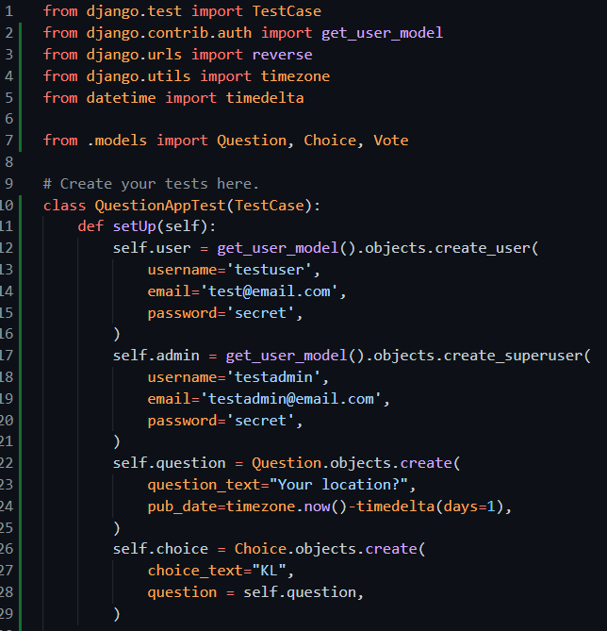
Add test code in tests.py

Slide 14
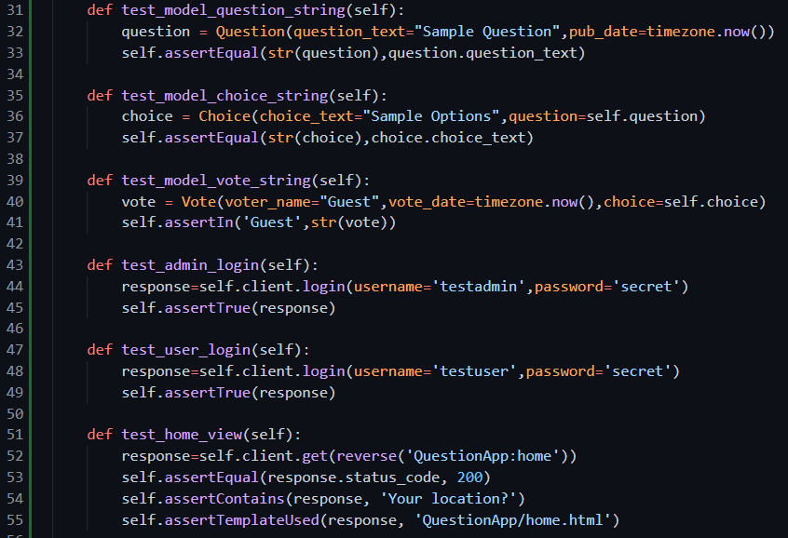

Slide 15
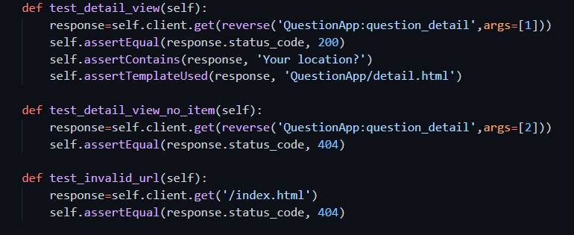

Slide 16
Run the test
Because we have static files, before running the test we need arrange static files into correct folder
py manage.py collectstatic
PS> py manage.py collectstatic
PS> py manage.py test

Slide 17
You can push all test code to remote repo.
After finish one feature, always share your code with your team and make it available to whole team.
As it is only meant for test, no need push it to product cloud server.
PS> cd QuestionPrj
PS> git status
PS> git add –A
PS> git commit –m “add test code”
PS> git push origin main

Slide 18
New function: view the results
Currently we still not develop the function for user to participate the questionnaire yet. This participate would need several steps of clicks as we have more than one questions, and would need session manage.
We will develop the view current result, as this view function is more simple compare to participate questionnaire.

Slide 19
Config the URL for viewing result
Add new URL for ‘/result/<int:pk>/’

Slide 20
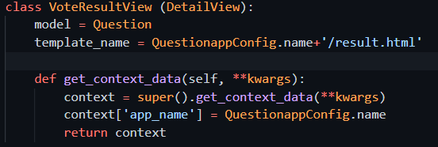
Add view for checking result
The new view also from the DetailView.
The main content is based on Question, although it added vote results. So it is using model Question’s detail (one item of Question).

Slide 21
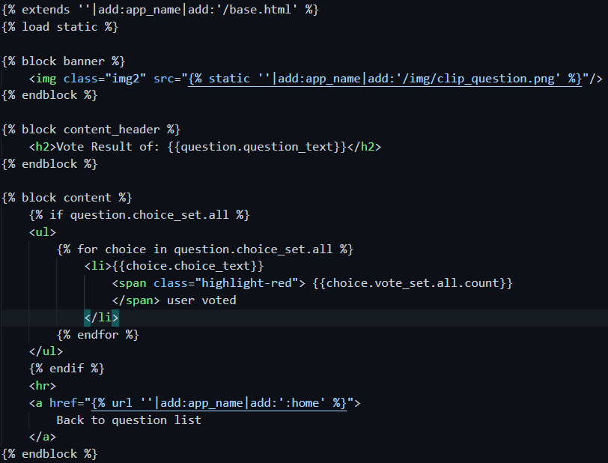
Add template
Exntends from base.html
All content similar to detail template. Only added how many users opt for the choice, and we show the text in red larger size.

Slide 22
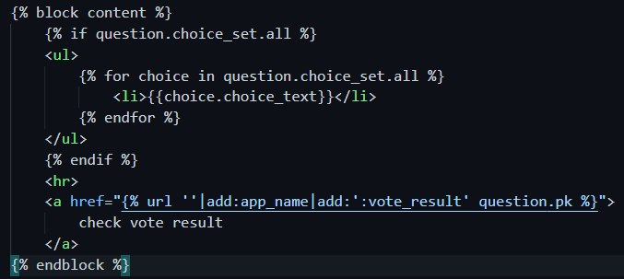
Change detail template a button to view result
At each question detail page, add one link to check the result.

Slide 23
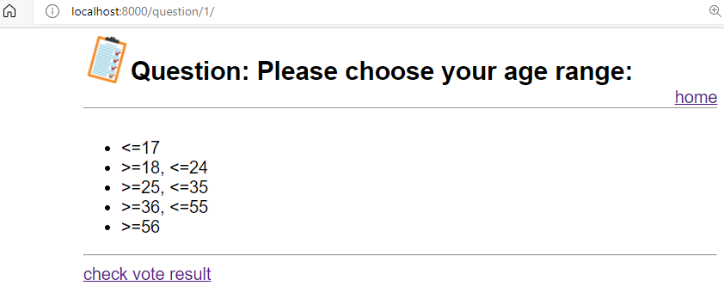
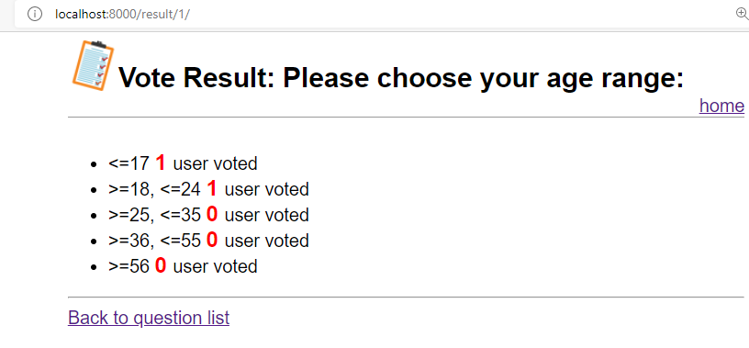
From the browser

Slide 24
You can push all code to remote repo. Deploy to heroku
PS> cd QuestionPrj
PS> git status
PS> git add –A
PS> git commit –m “add vote result”
PS> git push origin main
PS> git push heroku main
PS> heroku ps:scale web=1

